Slide 1
Skin Cancer Classification

Slide 2

Introduction
Skin cancer is one of the most common and life-threatening diseases.
In United States, skin cancer is most common type of cancer, with an estimated 5 million people treated each year for skin cancer.
One in five Americans develop skin cancer in their lifetime.
The importance of early skin cancer detection:
Early detection increases the chances of successful treatment.
Benefits for utilizing non-surgical techniques for detection of skin cancer.

Slide 3

Problem Statement
Challenges in early detection
Manual diagnosis can be time-consuming and prone to errors.
Skin lesions can vary widely, making them hard to diagnose.
Limited availability of expert dermatologists.
Solution: Deep learning in Medical Imaging
Using deep learning models like Convolutional Neural Network (CNNs), to classify skin lesions.
How deep learning can automate detection and reduce diagnostic errors.

Slide 4
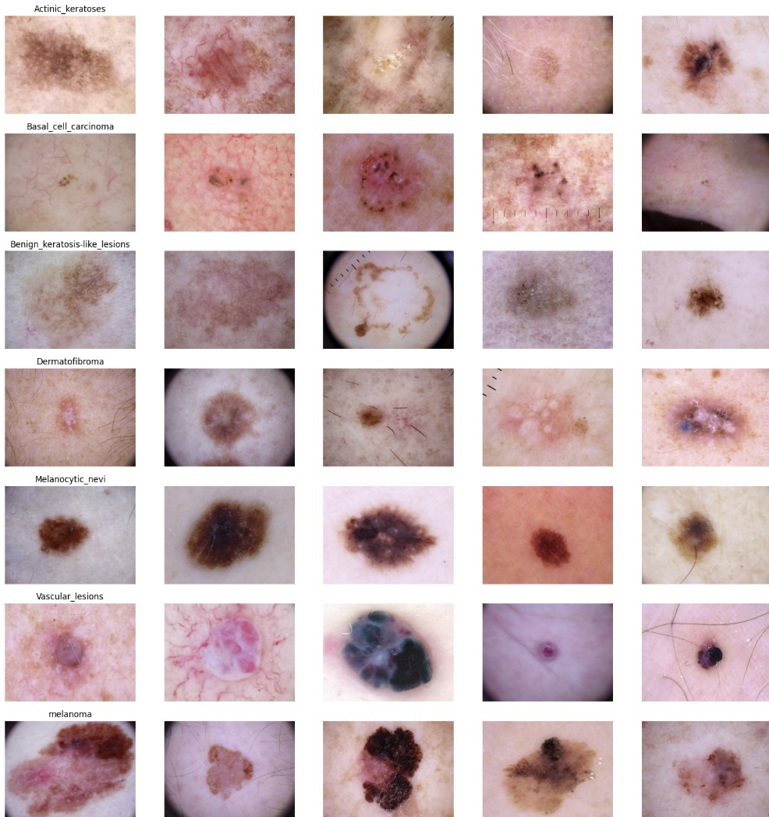
Data Collection
Dataset used: Skin Cancer MNIST: HAM10000
The HAM10000 dataset is a large collection of dermatoscopic images of pigmented skin lesions.
This dataset consists of 10,015 high-resolution images collected from various geographic regions and ethnic groups, ensuring diversity in skin tones and lesion types.
This dataset covers seven important lesion types, including melanoma (mel), basal cell carcinoma (bcc), and benign keratosis-like lesions (bkl), ensuring a diverse representation of pigmented skin conditions
Due to file size limitations, images are stored in two separate ZIP files and all images are stored in JPEG format, ensuring compatibility with various machine learning frameworks and ease of processing

Slide 5
Data Preprocessing
Image Resizing
Original images: 450 x 600 pixels
Resized to:
75 x 100 RGB for baseline model.
192 x 256 RGB for fine-tuning models.
Normalization
Pixels values scaled between 0 and 1 by dividing by 255.
This helps with faster convergence during model training.
Handling Class Imbalance
The dataset is Imbalanced.
Melanocytic Nevi (Type of skin lesion) has 7,000 images while other have fewer.
Weight adjustments are done in loss function
Splitting the Dataset
Training Set: 7,210 images (used for learning patterns)
Validation Set: 1,830 images (used for hyperparameter tuning)
Test Set: 1,002 images (used final evaluation)

Slide 6
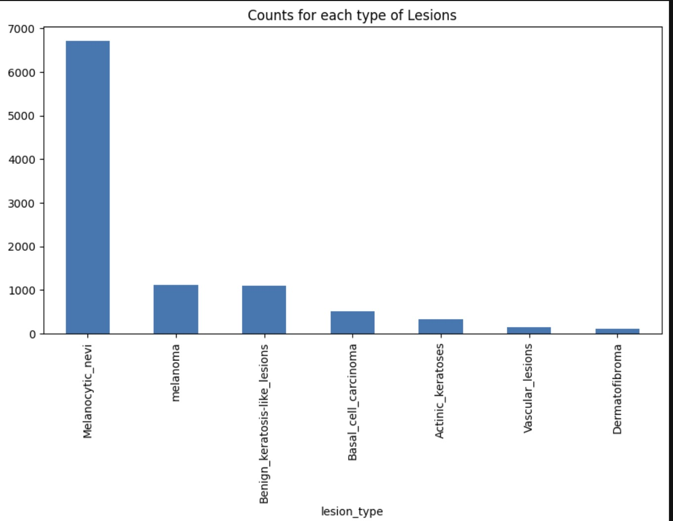
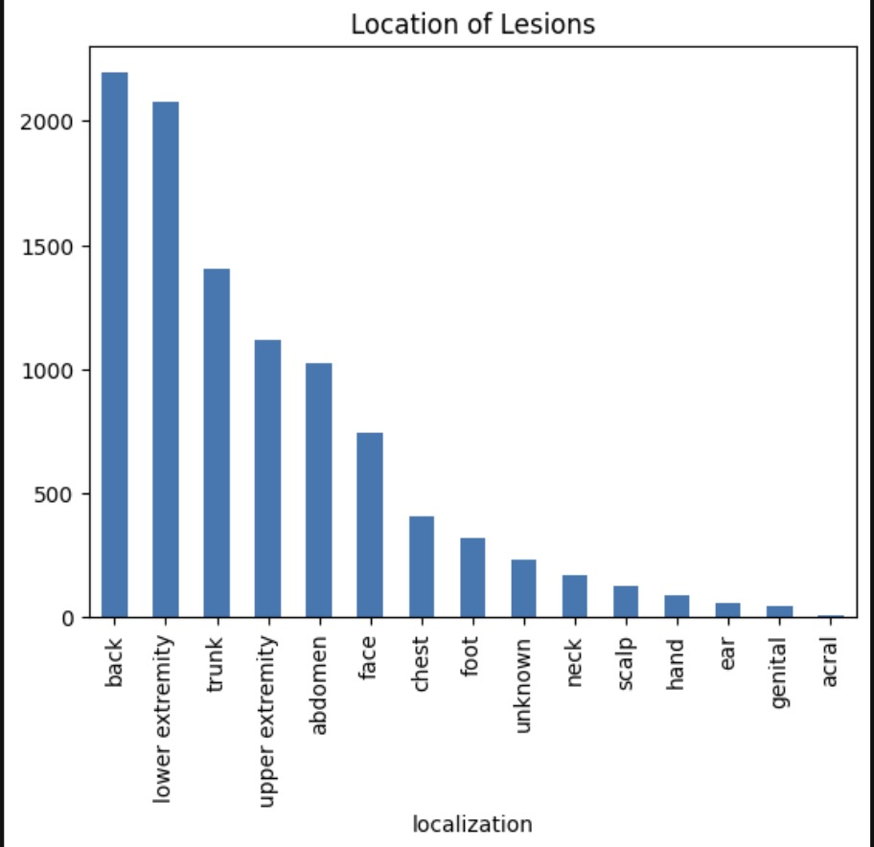
Exploratory Data Analysis
Skin Lesion Type Distribution Graph
Displays the number of images for each of the 7 lesion types.
Highlights the class imbalance (Melanocytic Nevi is the most common).
This helps us to determine the need for data augmentation or class balancing.
Lesion Location Distribution Graph
Visualizes where skin lesions commonly appear.
Helps understand whether location affects lesion type.

Slide 7
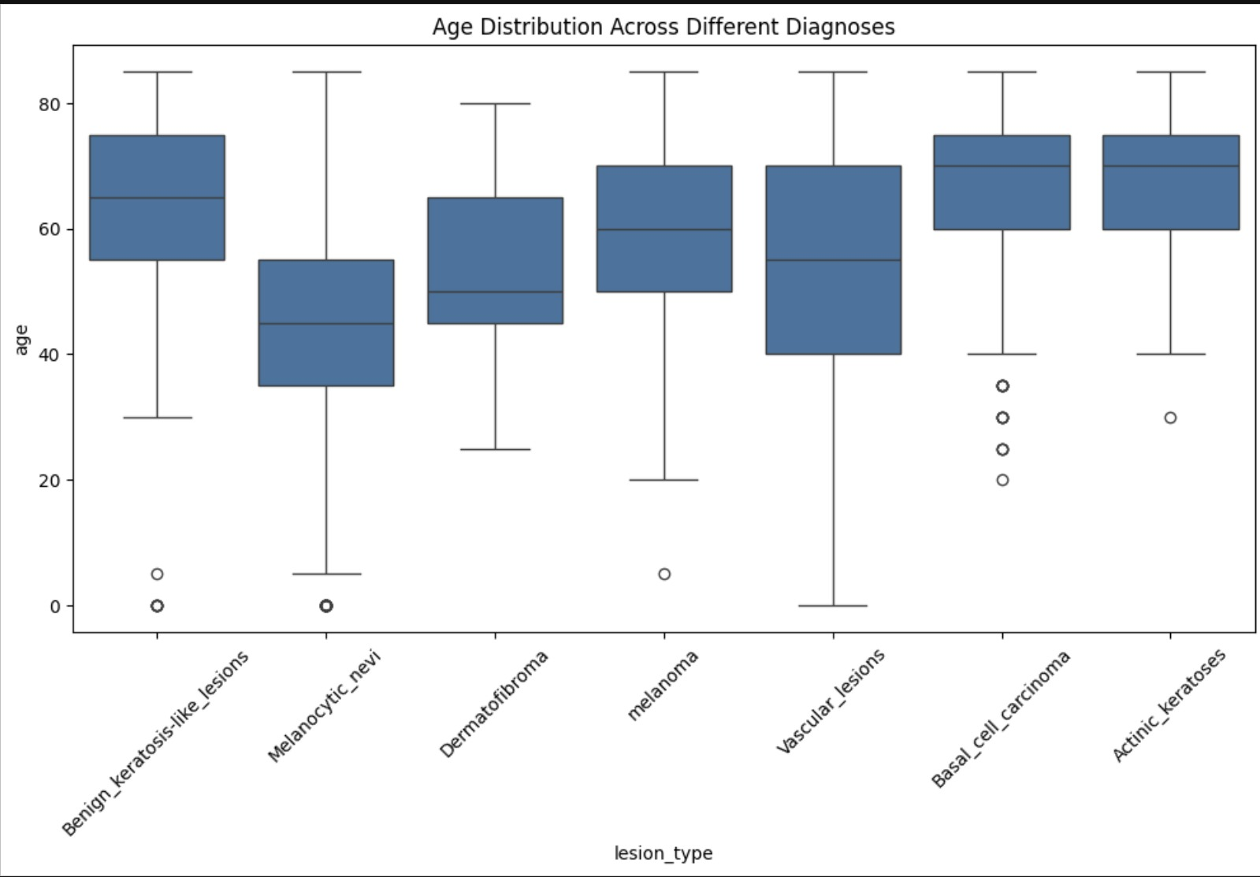
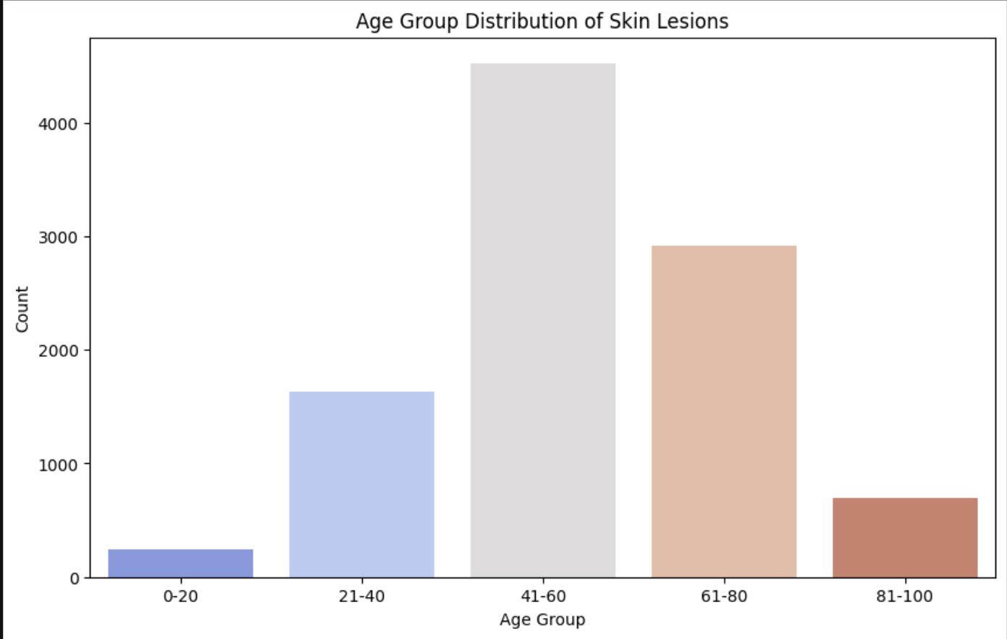
EDA
Age Distribution by Diagnosis
Shows how age varies across different skin lesion types.
Certain lesions, like melanoma, are common in older individuals.
This is useful for incorporating age as a predictive feature in the model.
Age Group Distribution of Skin Lesions
Groups patients into age brackets (0-20, 21-40, 41-60, 60+).
Helps identify high-risk age groups for certain lesions.
This can improve model predictions by incorporating age priors.

Slide 8
Model Architecture
Base Model: Convolutional Neural Network
Uses convolutional layers to automatically learn spatial hierarchies of features like edges, textures and object parts, making it ideal for tasks like medical image analysis.
Type: Convolutional Neural Network (CNN)
Input Shape: (75 x 100 pixels, 3 color channels)
Number of Output Classes: 7
Layers and Structures:
Convolutional Blocks
Block 1: 2 Conv2D layers
Block 2: 2 Conv2D layers
Pooling and Regularization: MaxPooling2D

Slide 9
Fully Connected Layers
Flatten layer
Dense (128 neurons, ReLu)
Dropout (50%)
Output Layer: Dense
Training & Optimization
Optimizer: Adam (learning rate = 0.001)
Loss Function: Categorical Crossentropy
Data Augmentation: Rotation, zoom, width/height shift
Training: 20 epochs, batch size = 10
Performance Metrics
Test Accuracy: 75.09%
Validation Accuracy: 79.12%
Loss: 0.66 (Test), 0.60 (Validation)

Slide 10
Model Architecture
InceptionV3:
A deep convolutional neural network (CNN) designed for high performance in image classification tasks.
We used Pretrained on ImageNet and fine-tuned for skin cancer detection in this project.
Total Layers: 315
Parameters: 22.8 million
Key Features of InceptionV3:
Reduces computational cost while maintaining accuracy.
Asymmetric Kernels: Uses 1x3 and 3x1 filters instead of standard 3x3, reducing complexity.

Slide 11
Methodology
Data Preprocessing
Resized images to 192 x 256 pixels
Normalized pixel values to range [0, 1] by dividing by 255
Optimization and Training
Optimizer: Adam
Loss Function: Categorical Cross Entropy
Batch Size: 32
Epochs: Tuned for optimal performance
Performance Metrics
Train Accuracy: 74.96%
Validation Accuracy: 78.93%

Slide 12
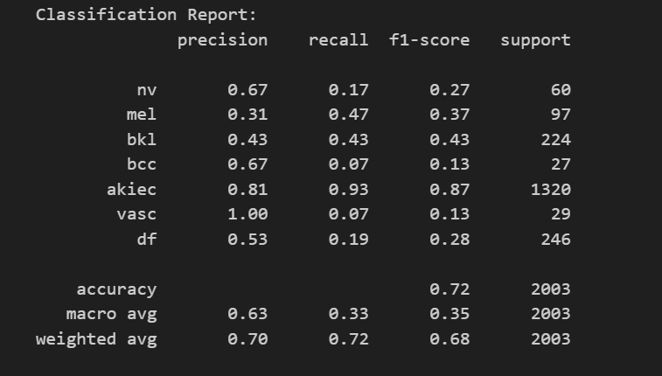
Results for InceptionV3:

Slide 13
Challenges Faced
Imbalanced Dataset
Melanocytic Nevi (nv) has 7,000+ images, while other lesion types have significantly fewer samples
This leads to biased model predictions favoring the majority class.
Overfitting
Fine-tuned models performed well on training data but struggled on unseen test data.
Required regularization techniques like dropout and data augmentation.
High Intra-Class Variability
Same lesion type can have different textures, colors, and shapes, making classification difficult.
Example: Melanoma and benign nevi look very similar
Low Inter-Class Variability
Different lesion types can appear visually similar, confusing the model.
Example: Benign keratosis (bkl) vs. Actinic keratosis (akiec)

Slide 14
Further Improvements
Data Preparation Improvements:
Class Balance Assessment: Analyze the distribution of classes to identify potential imbalances.
Class Balancing Implementation: Apply techniques to address class imbalances, ensuring fair representation.
Advanced Feature Creation: Investigate and implement novel feature extraction methods for enhanced model accuracy.
Model Architecture Improvements:
Deepening the CNN:
Increase the number of convolutional layers to capture more intricate patterns.
Expand to 3-4 convolutional blocks with larger filter sizes (e.g., 128, 256).
Integrating Batch Normalization:
Normalize activations after each layer to enhance stability and speed up convergence.
Incorporating Residual Connections (ResNet-style architecture)
Mitigates the vanishing gradient problem by allowing gradient flow through skip connections, making training deep models more effective.

Slide 15
References
Skin Cancer MNIST: HAM10000
https://www.labellerr.com/blog/detecting-skin-cancer-using-convolutional-neural-networks-a-comprehensive-guide/
[1] Zhangli Lan, Songbai Cai, Xu He, Xinpeng Wen. “ An Improved Capsules Network for Diagnosis of Skin Cancer”. Available: https://paperswithcode.com/paper/fixcaps-an-improved-capsules-network-for
[2] Carolin Flosdorf, Justin Engelker, Igor Keller, Nicolas Mohr. “ Skin Cancer Detection utilizing Deep Learning: Classification of Skin Lesion Images using a Vision Transformer”. Available: https://arxiv.org/html/2407.18554v2
[3] : Laila Moataz et al 2021 J. Phys.: Conf. Ser. 2128 012013. “Skin Cancer Diseases Classification using Deep Convolutional Neural Network with Transfer Learning Model”. Available: https://iopscience.iop.org/article/10.1088/1742-6596/2128/1/012013/pdf

Slide 16
Thank You

